Slide 1
Unit-2.2 Digital to Digital Conversion
Prepared By:
Prof. Vishal A. Polara
Assistant Professor
Information Technology Department
Birla Vishvakarma Mahavidyalaya Engineering College

Slide 2
Outline
1. DIGITAL TO DIGITAL CONVERSION
Line conding
Line coding schemes
Block coding
Scrambling
2. ANALOG TO DIGITAL CONVERSION
Pulse code modulation(PCM)
Delta Modulation(DM)
3. TRANSMISSION MODES
Parallel Tramsmission
Serial Transmission

Slide 3
1. Digital to digital conversion
There are three technique to convert digital data to digital signal.
Line coding, block coding and scrambling are the techniques to convert digital data to digital signal.

Slide 4
1.1 Line coding
It is the process of converting digital data to digital signals.
It converts a sequence of bits to a digital signal.
The digital data are recreated by decoding the digital signal.
Characteristics of line coding schemes
Signal element versus data element:
A signal element carries data element
A signal element is the shortest unit of a digital signal
Data element are what we want to send and signal element are what we send
Data elements are carried and signal elements are the carriers.

Slide 5
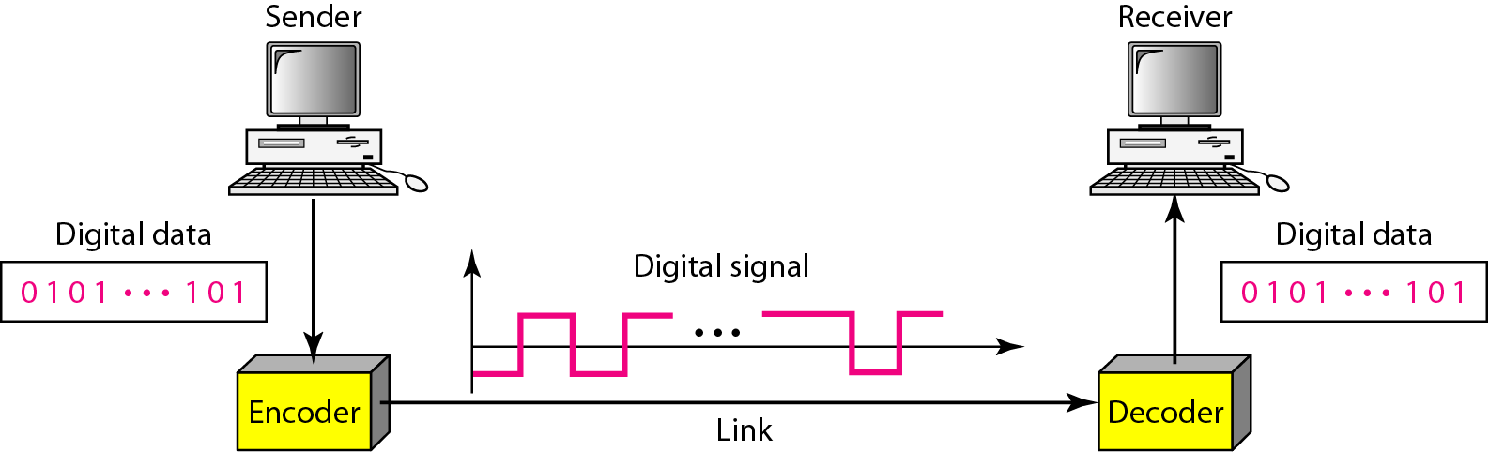
Figure Line coding and decoding

Slide 6
Data Rate Versus Signal Rate:
The data rate defines the number of data elements (bits) sent in 1s. The unit is bits per second (bps).
The signal rate is the number of signal elements sent in 1s. The unit is the baud.
Signal rate is sometimes called pulse rate, the modulation rate, or the baud rate
Increasing the data rate increases the speed of transmission and decreasing the signal rate decreases the bandwidth requirement.
Baseline Wandering
A running average of the received signal power calculated by receiver is called the baseline. A long string of 0s or 1s can cause a drift in the baseline which is called baseline wandering

Slide 7
DC Components
When the voltage level in a digital signal is constant for a while, the spectrum creates very low frequencies. Those frequencies around zero are called DC (Direct-current) Components
Self-sychronization
A self-synchronizing digital signal includes timing information in the data being transmitted.
Built-in Error Detection
It is desirable to have a built-in error-detecting capability in the generated code to detect some of or all the errors that occurred during transmission.
Immunity to Noise and Interference
It is a another desirable code characteristic. Some encoding schemes have this capability.
Complexity
A complex scheme is more costly to implement than a simple one. For example, a scheme that uses four signal levels is more difficult to interpret than one that uses only two levels.

Slide 8
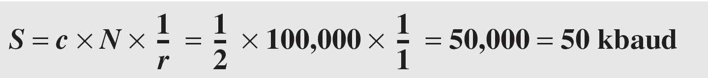
Relationship between data rate and signal rate:
N is the data rate (bps)
c is the case factor, which varies for each case; S is the number of signal elements;
r is the previously defined factor

Slide 9
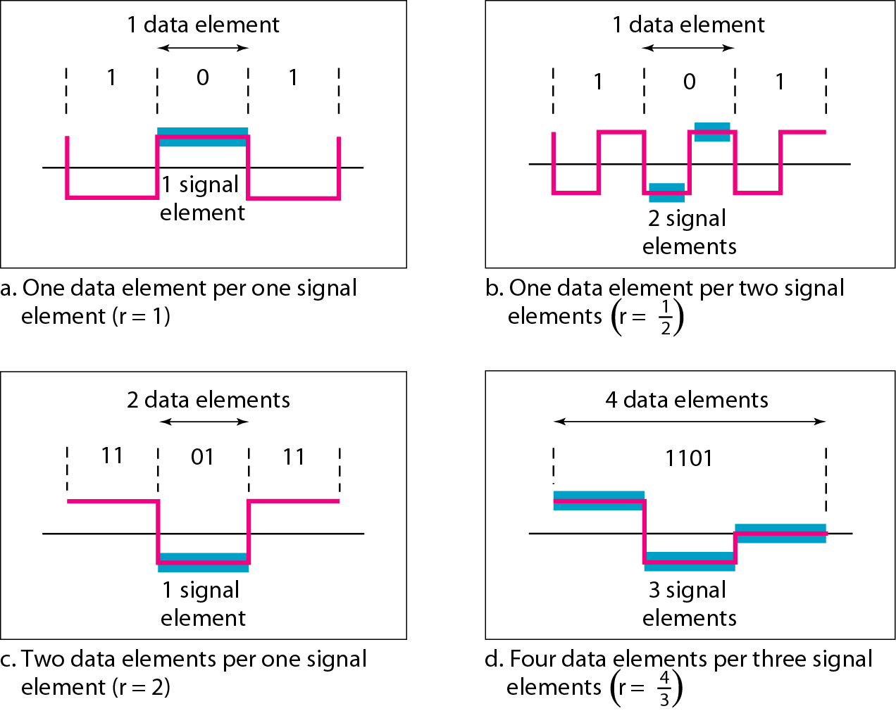
Figure Signal element versus data element

Slide 10
Example
A signal is carrying data in which one data element is encoded as one signal element ( r = 1). If the bit rate is 100 kbps, what is the average value of the baud rate if c is between 0 and 1?
Solution
We assume that the average value of c is 1/2 . The baud rate is then

Slide 11
Although the actual bandwidth of a digital signal is infinite, the effective bandwidth is finite.

Slide 12
Example
The maximum data rate of a channel (see Chapter 3) is Nmax = 2 × B × log₂ L (defined by the Nyquist formula). Does this agree with the previous formula for N_{max}?
Solution
A signal with L levels actually can carry log₂L bits per level. If each level corresponds to one signal element and we assume the average case (c = 1/2), then we have

Slide 13
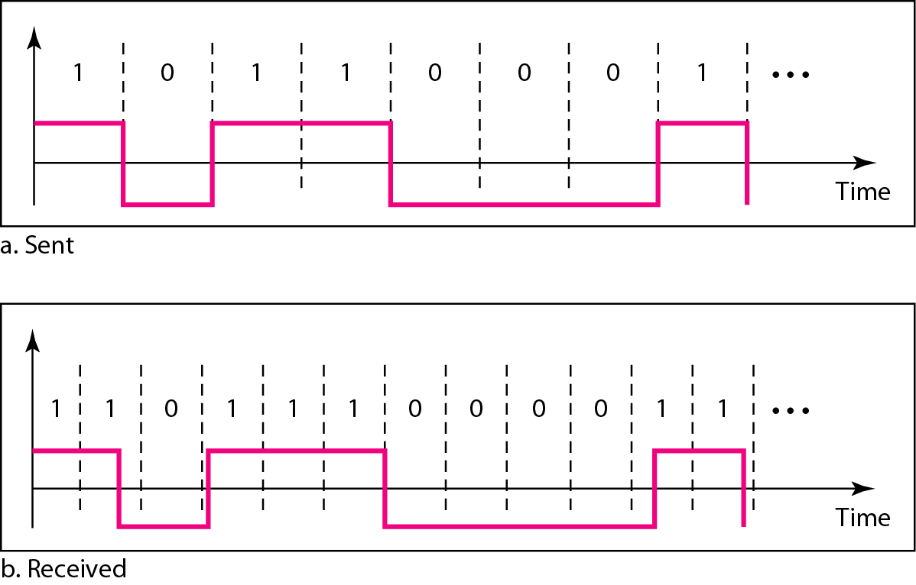
Figure 4.3 Effect of lack of synchronization

Slide 14
Example
In a digital transmission, the receiver clock is 0.1 percent faster than the sender clock. How many extra bits per second does the receiver receive if the data rate is 1 kbps? How many if the data rate is 1 Mbps?
Solution
At 1 kbps, the receiver receives 1001 bps instead of 1000 bps.
At 1 Mbps, the receiver receives 1,001,000 bps instead of 1,000,000 bps.

Slide 15
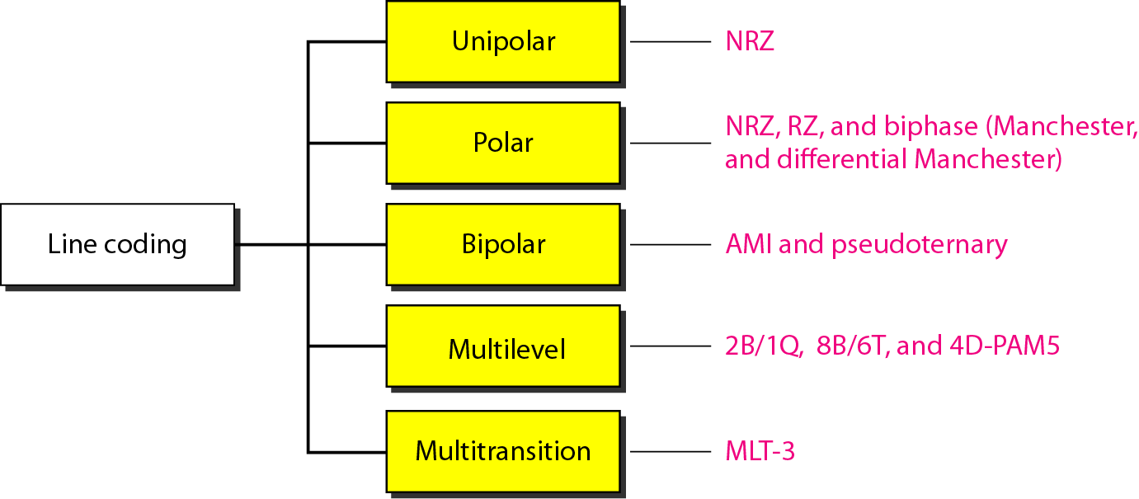
LINE CODING SCHEMES
Figure Line coding schemes

Slide 16
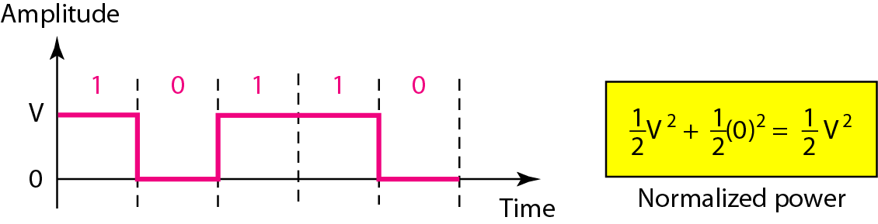
1. Unipolar Line Coding
It is called NRZ because the signal does not return to zero at the middle of the bit.
In this scheme positive voltage defines bit 1 and the zero voltage defines bit 0.
This scheme is vary costly compare to polar NRZ.
It has DC component problem and synchronization when long sequence of 0’s and 1’s .
It is obsolete technique.
1.1 NRZ Scheme
Figure Unipolar NRZ scheme

Slide 17
2. Polar Line Coding
In polar line coding scheme voltages are on the both sides of the time axis.
Voltage level for 0 can be positive and the voltage level for 1 can be negative.
In polar NRZ encoding we use two levels of voltage amplitude.
There are two version of NRZ: NRZ-L and NRZ-I.
In NRZ-L the level of the voltage determines the value of the bit.
In NRZ-I the inversion or the lack of inversion determines the value of the bit.
If there is no change if bit is 0, there is a change if the bit is 1.
There is a problem of baseline wandering for both the variations.
If there is a long sequence of 0s and 1s in NRZ-L, the average signal power is skewed.
In NRZ-I this problem occurs only for a long sequence of 0s. By eliminating sequence of 0s we can avoid baseline wandering.
The synchronization problem is there in both the scheme. Long seqence of 1s affect only NRZ-I and 0s in both.
In NRZ-L another problem of sudden change of polarity where 0 becomes 1 and 1 becomes 0.
Both the scheme have DC component problem.
NRZ-L and NRZ-I both have an average signal rate of N/2 Bd.

Slide 18
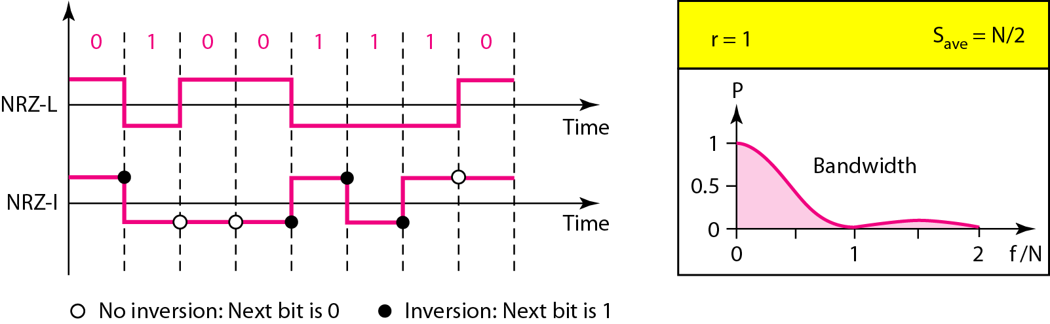
2. Polar Line Coding
2.1 NRZ Scheme – NRZ-L & NRZ-I
Figure Polar NRZ-L and NRZ-I schemes

Slide 19
Example
A system is using NRZ-I to transfer 10-Mbps data. What are the average signal rate and minimum bandwidth?
Solution
The average signal rate is S = N/2 = 500 kbaud. The minimum bandwidth for this average baud rate is Bmin = S = 500 kHz.

Slide 20
Return to zero (RZ)
The main problem with NRZ encoding occurs when the sender and receiver clocks are not synchronized. The receiver does not know when one bit has ended and the next bit is starting.
RZ (return to zero) has three values: Positive, Negative and Zero.
Here signal changes not between bits but during the bit.
It requires two signal changes to encode a bit and occupies grater bandwidth that is disadvantage of this scheme.
Sudden change in polarity problem is also exist.
Very good Synchronization.
There is no dc component problem.
RZ uses three levels of voltage which is more complex to create.
Due to this disadvantage this scheme is not used today.

Slide 21
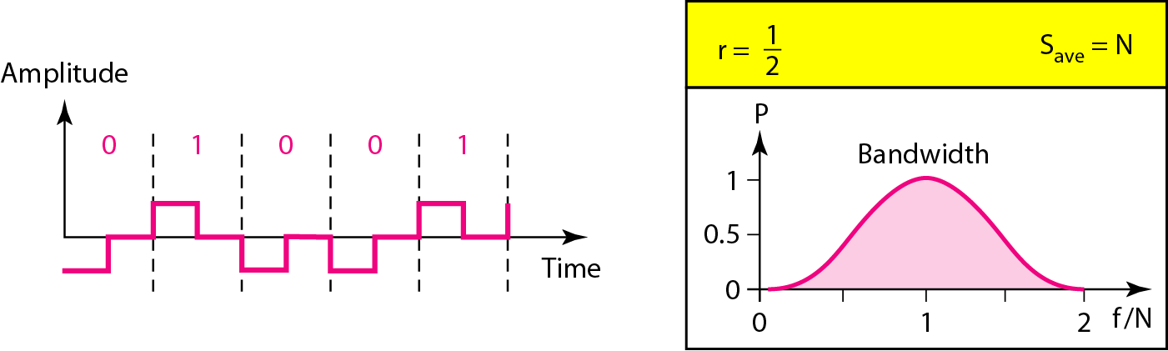
2. Polar Line Coding
2.2 RZ Scheme
Figure Polar RZ scheme

Slide 22
Biphase: Manchester and differential manchester
The idea of RZ and NRZ-L are combined into the manchester scheme.
In manchester encoding the duration of the bit is divided into two levels.
The voltage remain at one level during the first half and moves to the other level in the second half.
The transition at the middle of the bit provides synchronization.
Differential manchester is the combination of RZ and NRZ-I.
There is always a transition at the middle of the bit but the bit values are determined at the beginning of the bit.
If the next bit is 0, there is a transition, if the next bit is 1 there is none.
There is no baseline wandering and no DC component problem as each bit has positive and negative voltage contribution.
Drawback is signal rate because it is twice than NRZ.

Slide 23
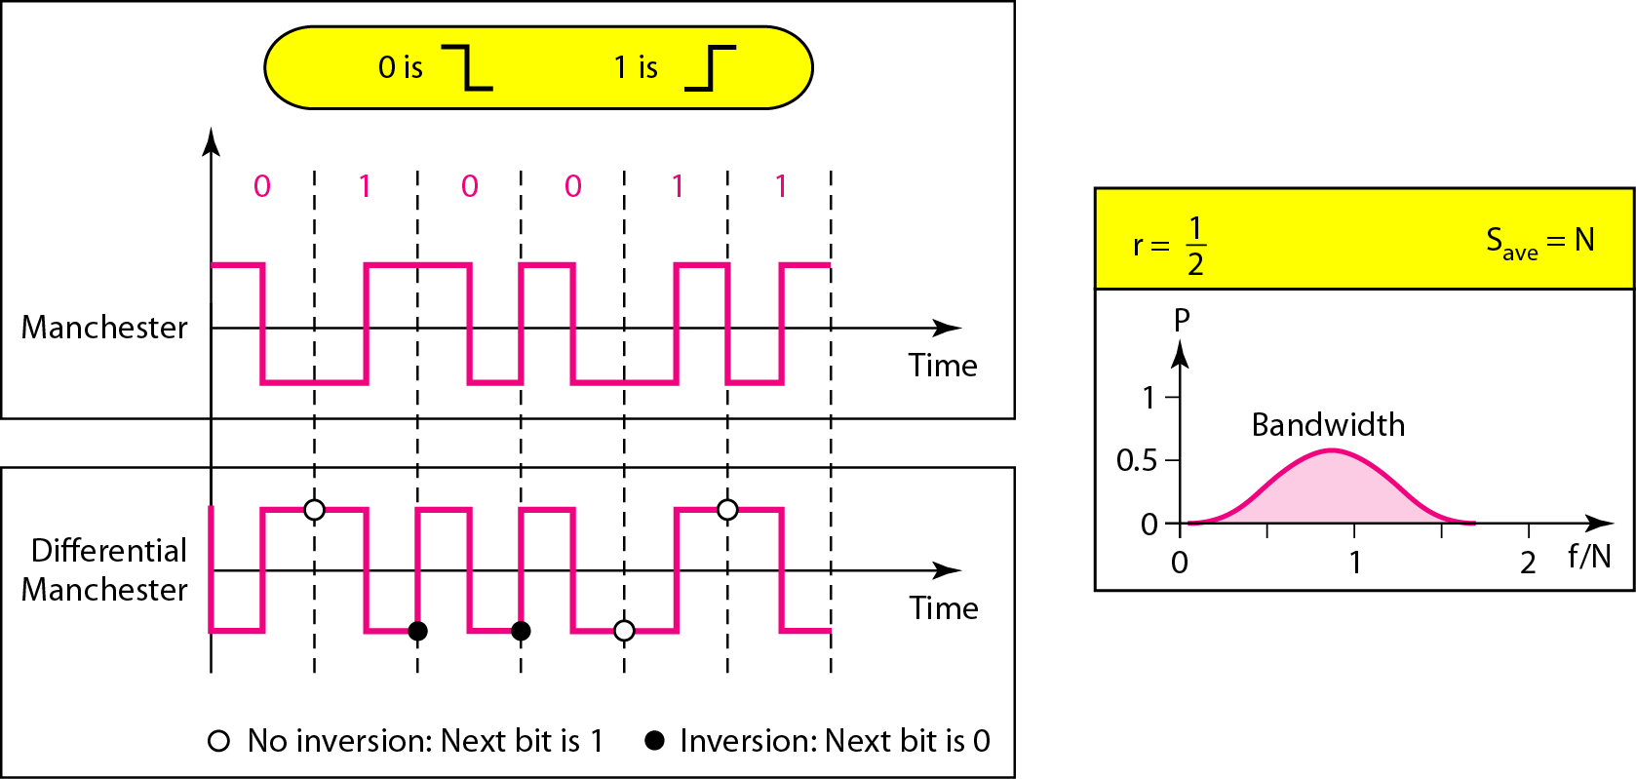
2. Polar Line Coding
2.3 Biphase scheme – Manchester & differential Manchester
Figure Polar biphase: Manchester and differential Manchester schemes

Slide 24
In Manchester and differential Manchester encoding, the transition
at the middle of the bit is used for synchronization.
The minimum bandwidth of Manchester and differential Manchester is 2 times that of NRZ.

Slide 25
Bipolar Schemes
There are three voltage level: positive, negative and zero. The voltage level for one data element is at zero, while the voltage level for the other element alternates between positive and negative.
AMI(alternate mark inversion) is bipolar scheme.
In the term alternate mark inversion the word mark comes from telegraphy and means 1 so AMI means alternate 1 inversion.
A neutral zero voltage represents binary 0. binary 1s are represented by alternating positive and negative voltages.
A variation of AMI encoding is called pseudoternary in which the 1 bit is encoded as a zero voltage and the 0 bit is encoded as alternating positive and negative voltages.
Bipolar scheme is an alternative to NRZ. It has same signal rate as NRZ but there is no DC component.
If there is long sequence of 1s the voltage level alternates between positive and negative therefore there is no DC component.
The constant zero voltage does not have a DC component.
AMI is commonly used for long distance communication but it has a synchronization problem when a long sequence of 0s is present. Scrambling can resolve this problem.

Slide 26
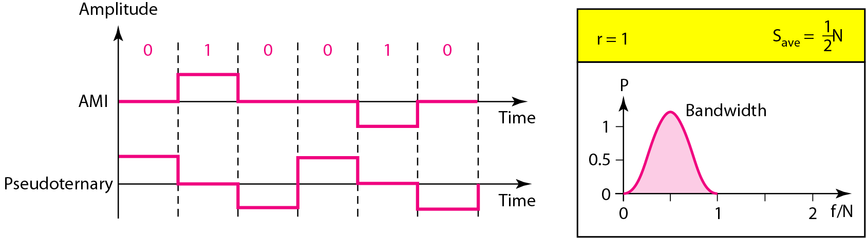
3. Bipolar Line Coding
3.1 AMI & Pseudoternary
Figure Bipolar schemes: AMI and pseudoternary
In bipolar encoding, we use three levels: positive, zero, and negative.

Slide 27
4. Multilevel schemes
In mBnL schemes, a pattern of m data elements is encoded as a pattern of n signal elements in which 2^{m} ≤ L^{n}.
L=2, T(ternary) for L=3 and Q(quaternary) for L=4

Slide 28
Multilevel Schemes
The goal of this scheme is to increase the number of bits per baud by encoding a pattern of m data elements into a pattern of n signal elements.
If we 2^{m}=L^{n} then each data pattern is encoded into one signal pattern.
If 2^{m} < L^{n} data patterns occupy only a subset of signal patterns. subset can be carefully designed to prevent baseline wandering, to provide synchronization.
If 2^{m} > L^{n} data encoding is not possible because some of the data patterns cannot be encoded.

Slide 29
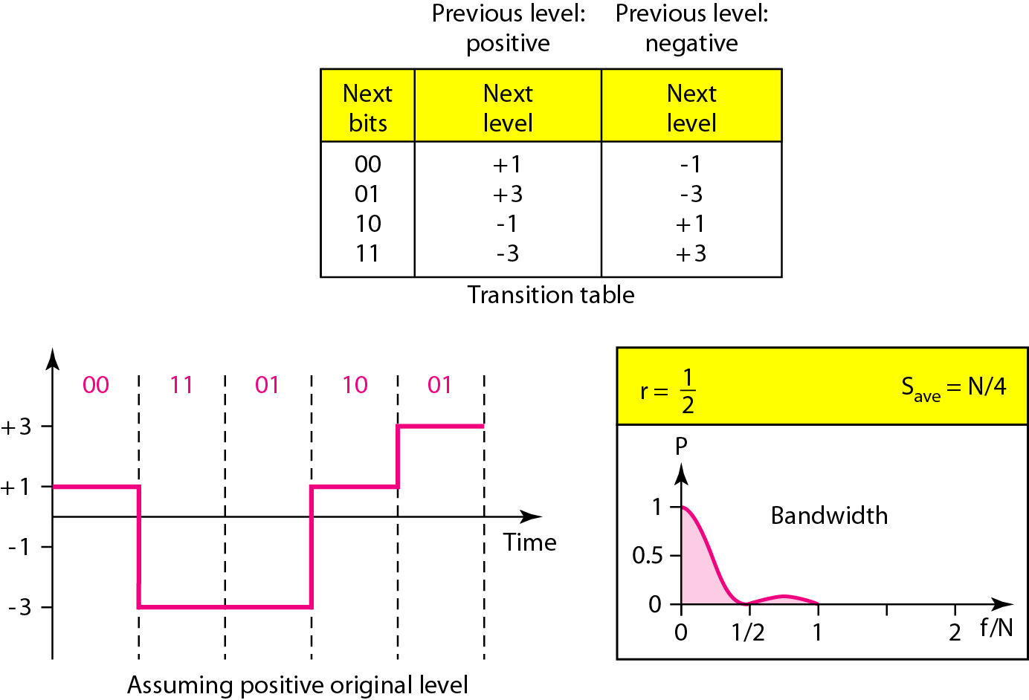
4.1 2B1Q Scheme
It is used in DSL
For high speed internet
High data rate
No redundant pattern
Figure Multilevel: 2B1Q scheme

Slide 30
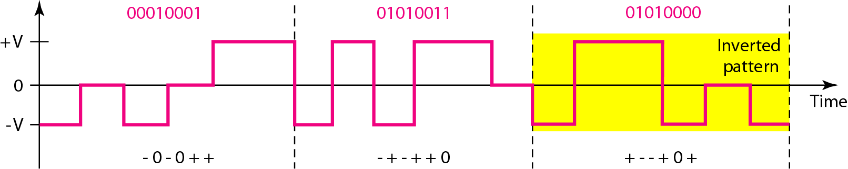
4.2 8B6T Scheme
Figure Multilevel: 8B6T scheme

Slide 31
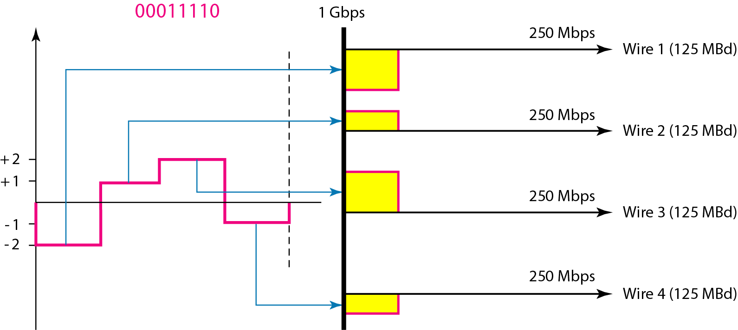
4.3 4D-PAM5 Scheme
Figure Multilevel: 4D-PAM5 scheme

Slide 32
Multiline transmission (MLT-3)
The multiline transmission three level(MLT-3) scheme uses three levels(+V, 0 and –V) and three transition rules to move between the levels.
The shape of signal in this scheme is used to reduced bandwidth.
If the next bit is 0, there is no transition.
If the next bit is 1 and the current level is not 0 the next level is 0.
If the next bit is 1 and the current level is 0 the next level is the opposite of the last nonzero level.
In worse case scenario when all 1’s are there pattern get repeated after every four time 1’s
It has signal rate one fourth the bit rate.

Slide 33
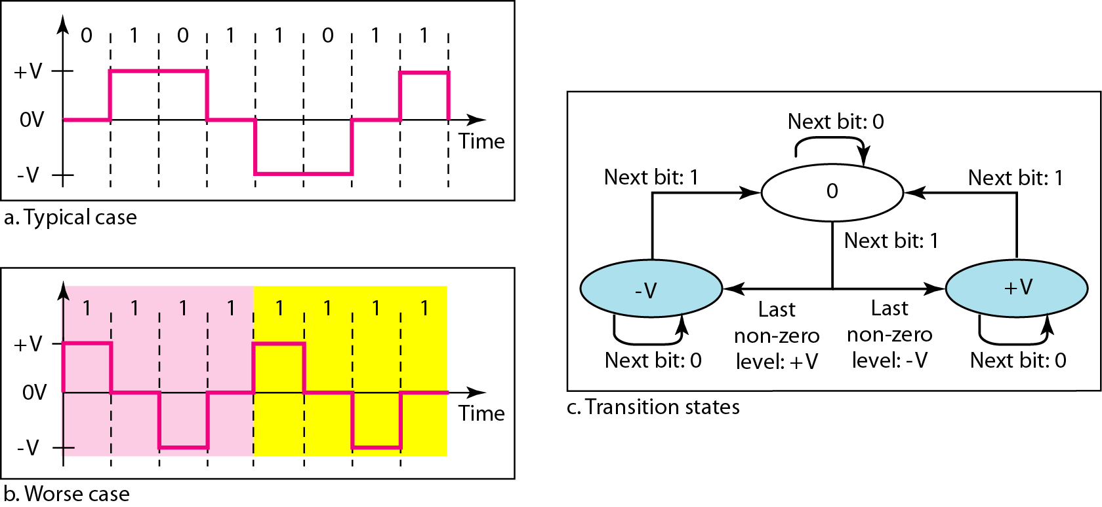
5. Multi-transition schemes
5.1 MLT-3 Scheme
Figure Multitransition: MLT-3 scheme

Slide 34
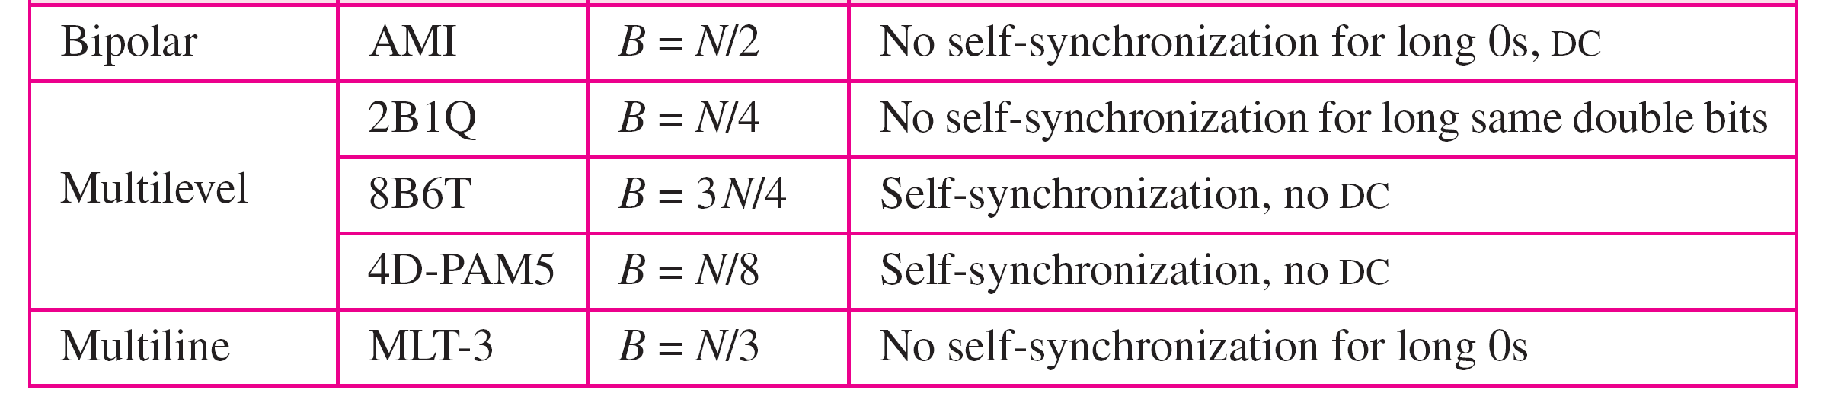
Table Summary of line coding schemes

Slide 35
1.2 BLOCK CODING SCHEMES
Block coding is normally referred to as mB/nB coding;
it replaces each m-bit group with an n-bit group.

Slide 36
Block Coding
Redundancy is required to ensure synchronization and to provide error detection.
Block coding changes a block of m bits into a block of n bits, where n is larger than m
It has three steps: division, substitution, and combination.

Slide 37
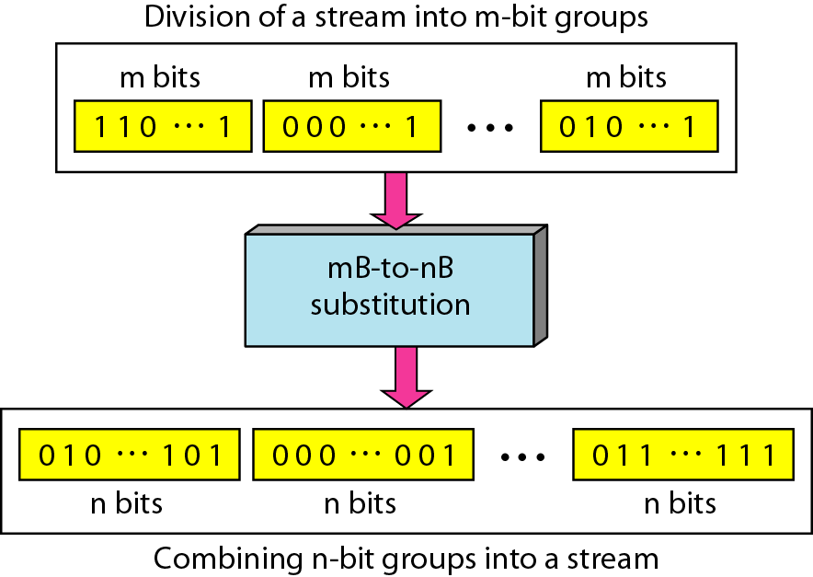
Figure Block coding concept

Slide 38
1. 4B/5B scheme
The four binary/five binary coding scheme was designed to be used in combination with NRZ-I.
In NRZ-I there is synchronization problem but that can change in this scheme by removing long sequences of 0’s
This scheme doesnot have more than three consecutive 0’s
Here 5bit output replaces 4-bit input with no more than one leading zero(left bit) and no more than two trailing zeros(right bits).
A group of 4 bits can have only 16 different patters while group of 5 bits can have 32 different patters so only 16 patters use for encoding and other uses for error detection code.
If 5 bit block is from unused portion it shows error code.
It can not solve DC component problem of NRZ-I.

Slide 39
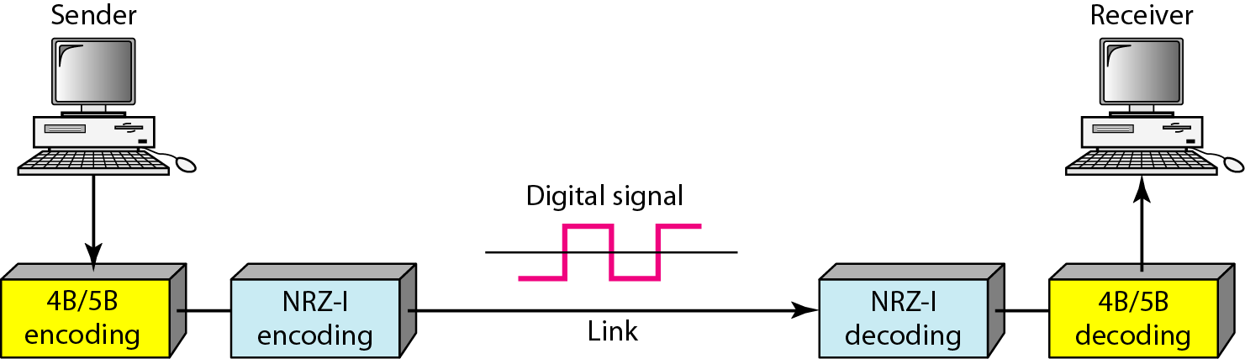
1. 4B/5B scheme
Figure Using block coding 4B/5B with NRZ-I line coding scheme

Slide 40
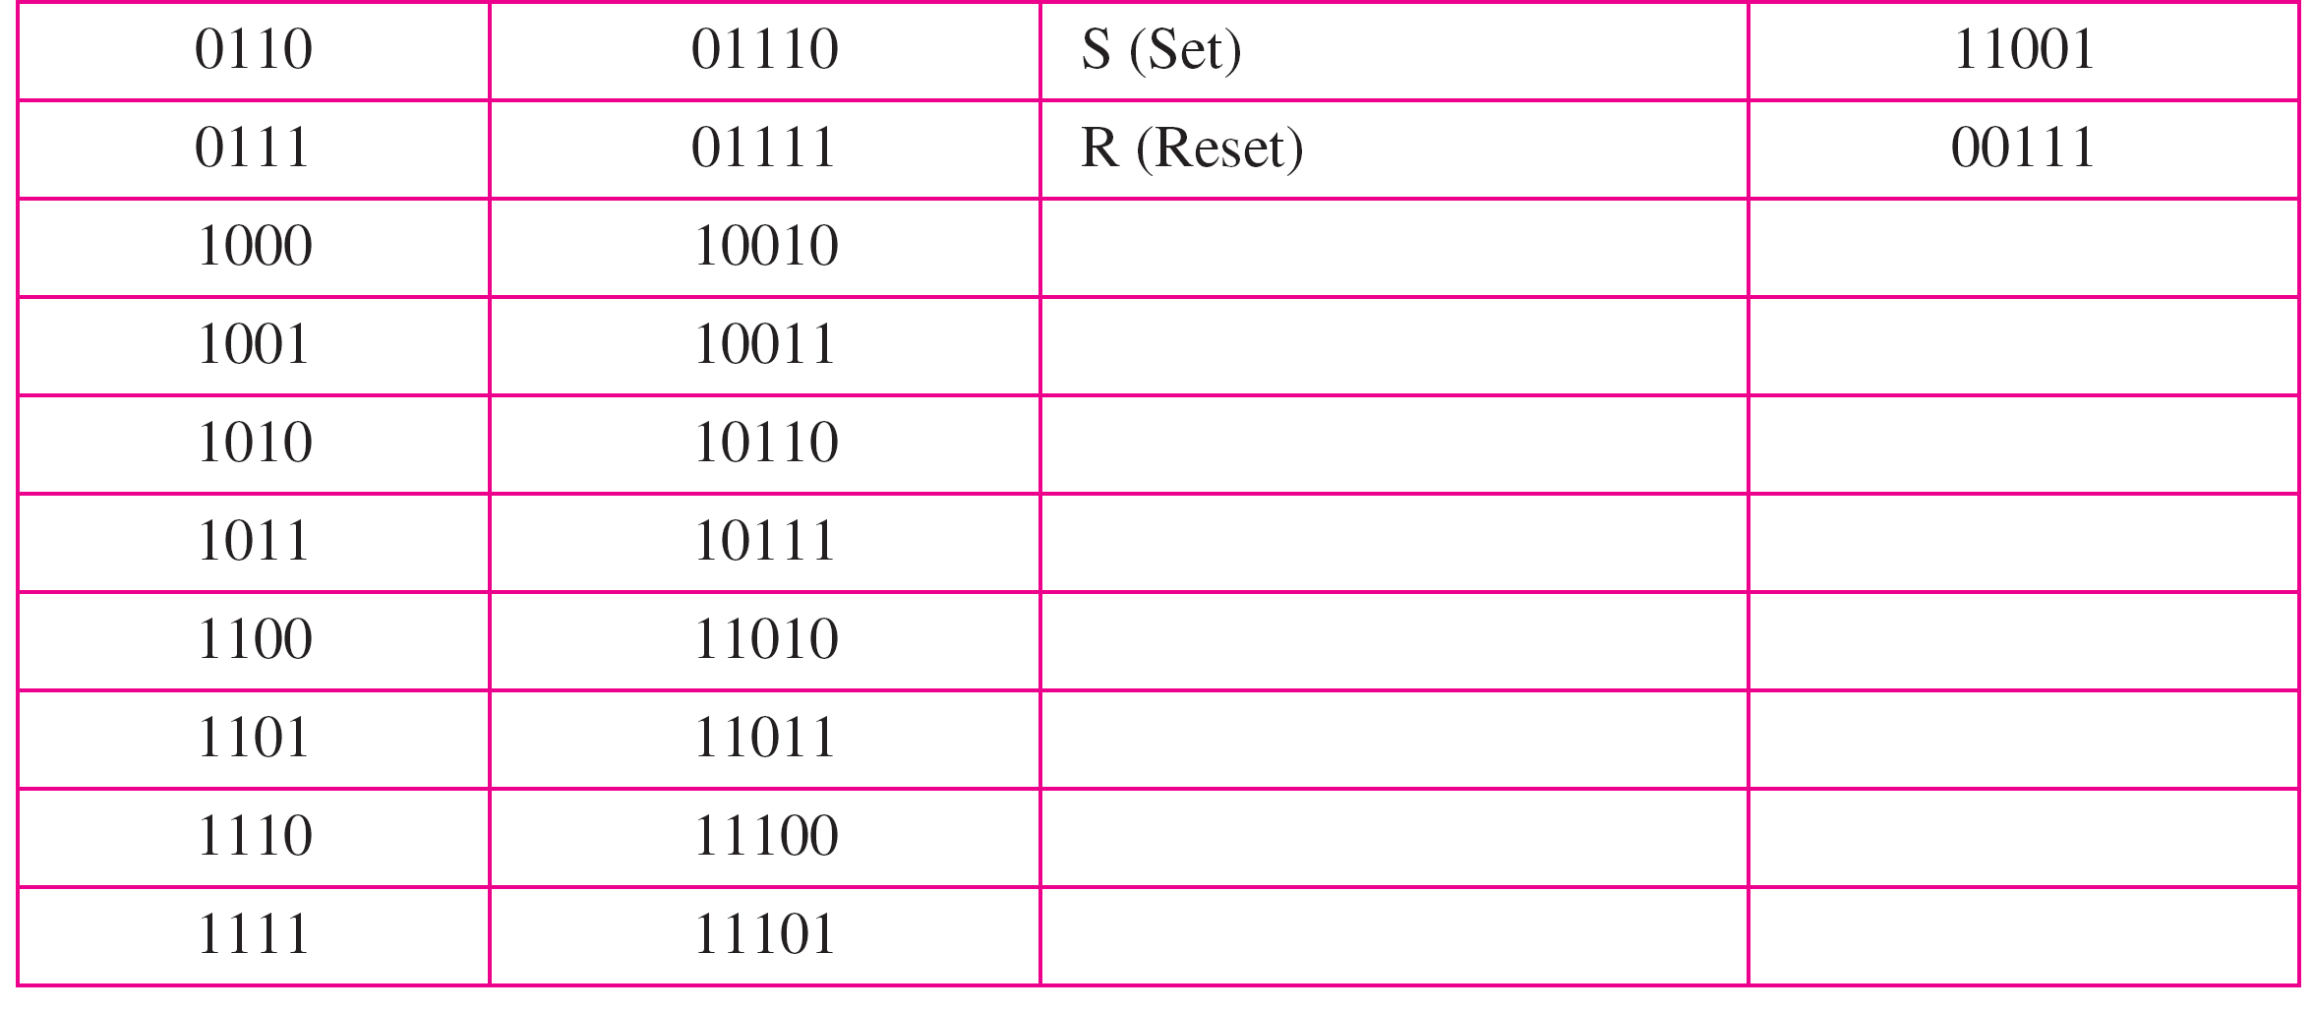
Table 4B/5B mapping codes

Slide 41
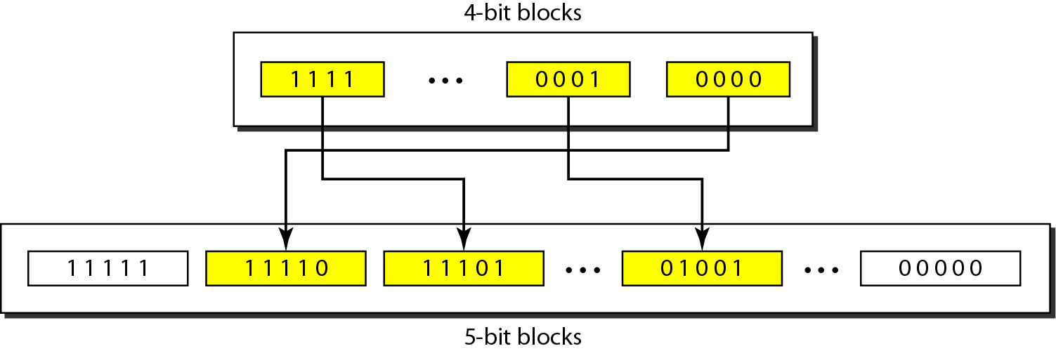
Figure Substitution in 4B/5B block coding

Slide 42
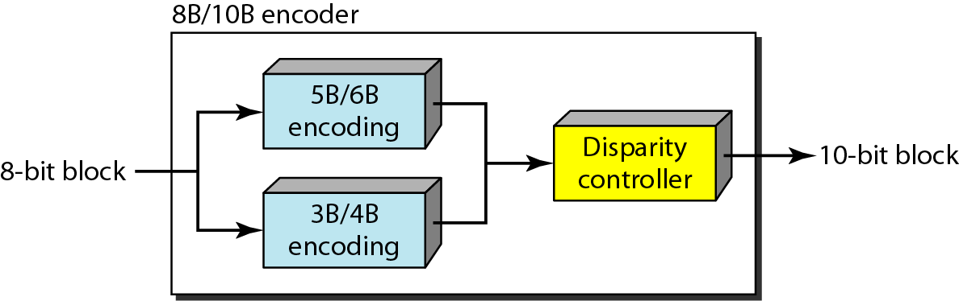
2. 8B/10B scheme
Figure 8B/10B block encoding

Slide 43
1.3 Scrambling
Biphase scheme is suitable for LAN and not for long distance communication because of wide bandwidth requirement.
Combination of block coding and NRZ line coding not suitable for long distance because of DC component.
Bipolar AMI encoding doesnot have DC component but have synchronization problem.
Scrambling is technique that doesnot increase number of bits and provide synchronization.

Slide 44
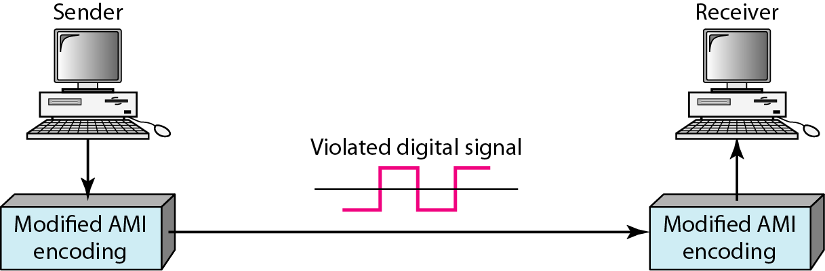
SCRAMBLING
Figure 4.18 AMI used with scrambling

Slide 45
B8ZS
Bipolar with 8-zero substitution is commonly used in north america.
In this technique eight consecutive zero-level voltages are replaced by the sequences of 000VB0VB. Here V is Violation means opposite polarity from previous and B is Bipolar which means nonzero level voltage in accordance with the AMI rule.
Here two positive and two negative voltage supply which maintain DC component.
V means the same polarity as the polarity of the previous non zero pulse and B means the polarity opposite to the polarity of the previous nonzero pulse.

Slide 46
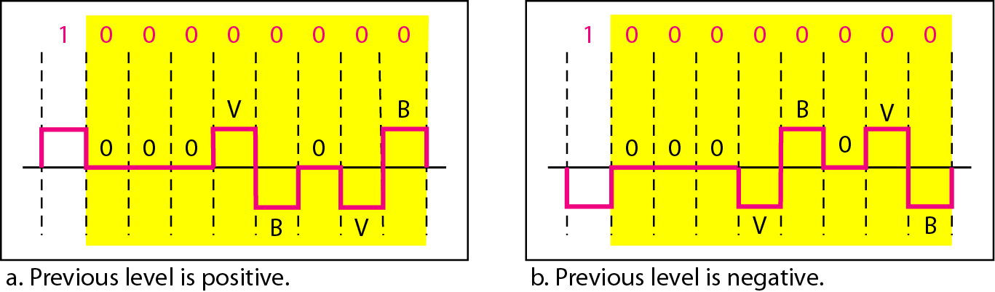
1. B8ZS scheme
B8ZS substitutes eight consecutive zeroes with 000VB0VB.
Figure Two cases of B8ZS scrambling technique

Slide 47
HDB3
High-density bipolar 3-zero is commonly used outside of north america.
In this technique for consecutive zeros are replace with a sequence of 000V and B00V.
This two patter maintain the even number of non zero pulses after each substitution.
There are two rules:
If the number of nonzero pulse after the last substitution is odd, the substitution pattern will be 000V which makes the total number of nonzero pulse even.
If the number of nonzero pulse after the last substitution is even, the substitution pattern will be B00V, which makes the total number of nonzero pulses even.
If no there is no 1’s put B00V pattern.

Slide 48
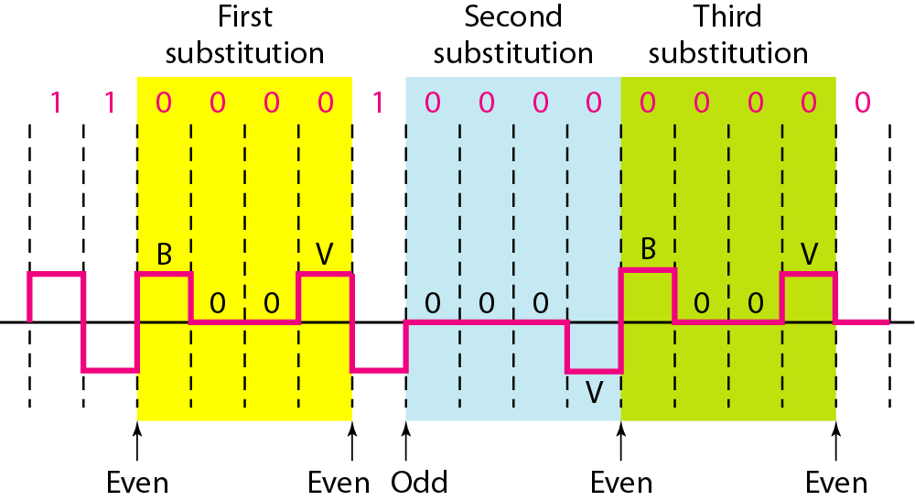
2. HDB3 scheme
HDB3 substitutes four consecutive zeroes with 000V or B00V depending on the number of nonzero pulses after the last substitution.
Figure Different situations in HDB3 scrambling technique

Slide 49
2. ANALOG-TO-DIGITAL CONVERSION
digital signal is superior to an analog signal. The tendency today is to change an analog signal to digital data. In this section we describe two techniques, pulse code modulation and delta modulation.
There are two techniques:
Pulse Code Modulation(PCM)
The analog signal is sampled
The sampled signal is quantized
The quantized values are encoded as streams of bits
2. Delta Modulation(DM)

Slide 50
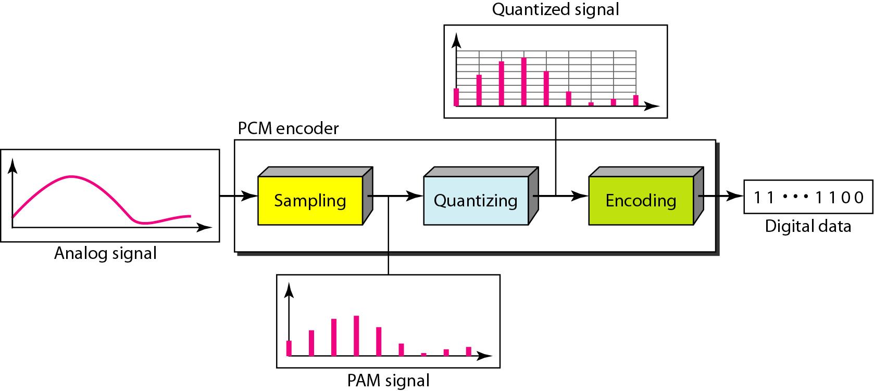
A. Pulse Code Modulation (PCM)
Figure Components of PCM encoder

Slide 51
1. Sampling
The analog signal is sampled every Ts where Ts is sample period.
The inverse of sample period is called the sampling rate or frequency.
There are three sampling method: Ideal, natural, flat-top
In Ideal Sampling method pulses from the analog signal is sampled.
In natural method high speed switch is turned on for only the small period of time when the sampling occurs.
In flat-top method samples created using a circuit.
The sampling process is called pulse amplitude modulation.

Slide 52
1. Sampling
Sampling Rate: Sampling rate be at least twice the highest frequency in the original signal.
If the signal is band limited then only sampling is possible , signal of infinite bandwidth cannot be sampled.
If the analog signal is low-pass the bandwidth and the highest frequency are the same value.
IF the analog signal is band-pass the bandwidth value is lower than the value of the maximum frequency.

Slide 53
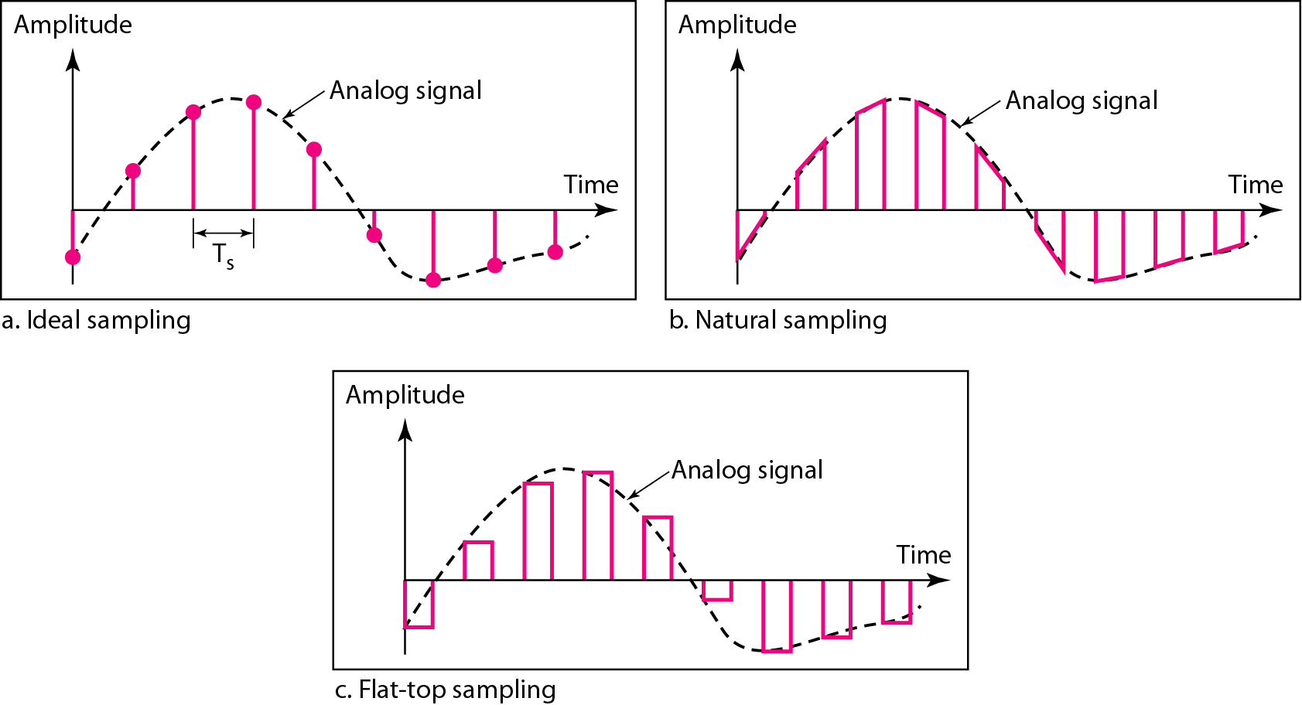
1. Sampling
Figure Three different sampling methods for PCM

Slide 54
According to the Nyquist theorem, the sampling rate must be
at least 2 times the highest frequency contained in the signal.

Slide 55
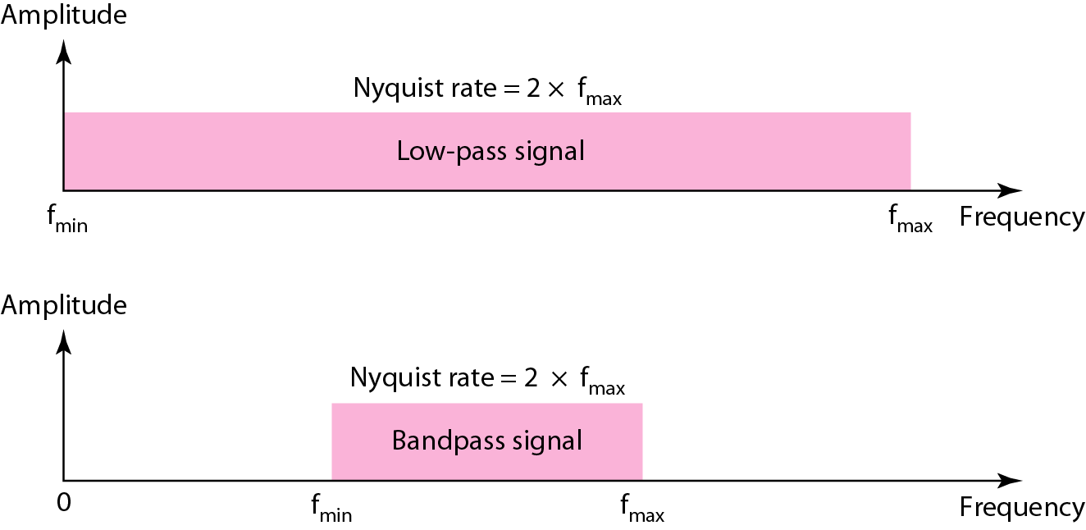
Figure Nyquist sampling rate for low-pass and bandpass signals

Slide 56
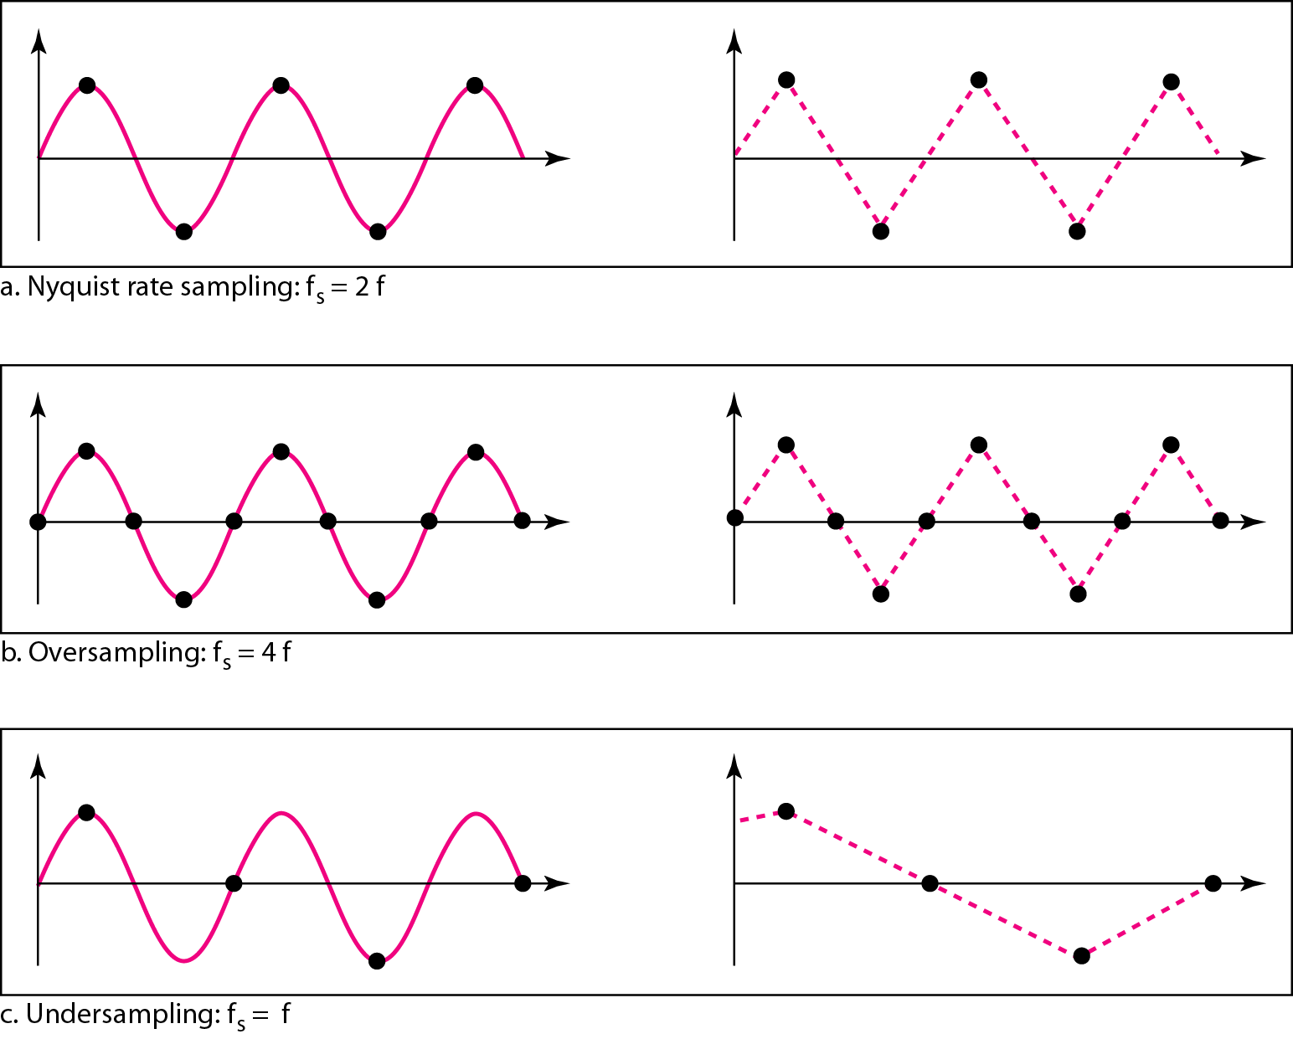
Figure Recovery of a sampled sine wave for different sampling rates

Slide 57
Example
Consider the revolution of a hand of a clock. The second hand of a clock has a period of 60 s. According to the Nyquist theorem, we need to sample the hand every 30 s (T_{s} = T or f_{s} = 2f ). In Figure 4.25a, the sample points, in order, are 12, 6, 12, 6, 12, and 6. The receiver of the samples cannot tell if the clock is moving forward or backward. In part b, we sample at double the Nyquist rate (every 15 s). The sample points are 12, 3, 6, 9, and 12. The clock is moving forward. In part c, we sample below the Nyquist rate (T_{s} = T or f_{s} = f ). The sample points are 12, 9, 6, 3, and 12. Although the clock is moving forward, the receiver thinks that the clock is moving backward.

Slide 58
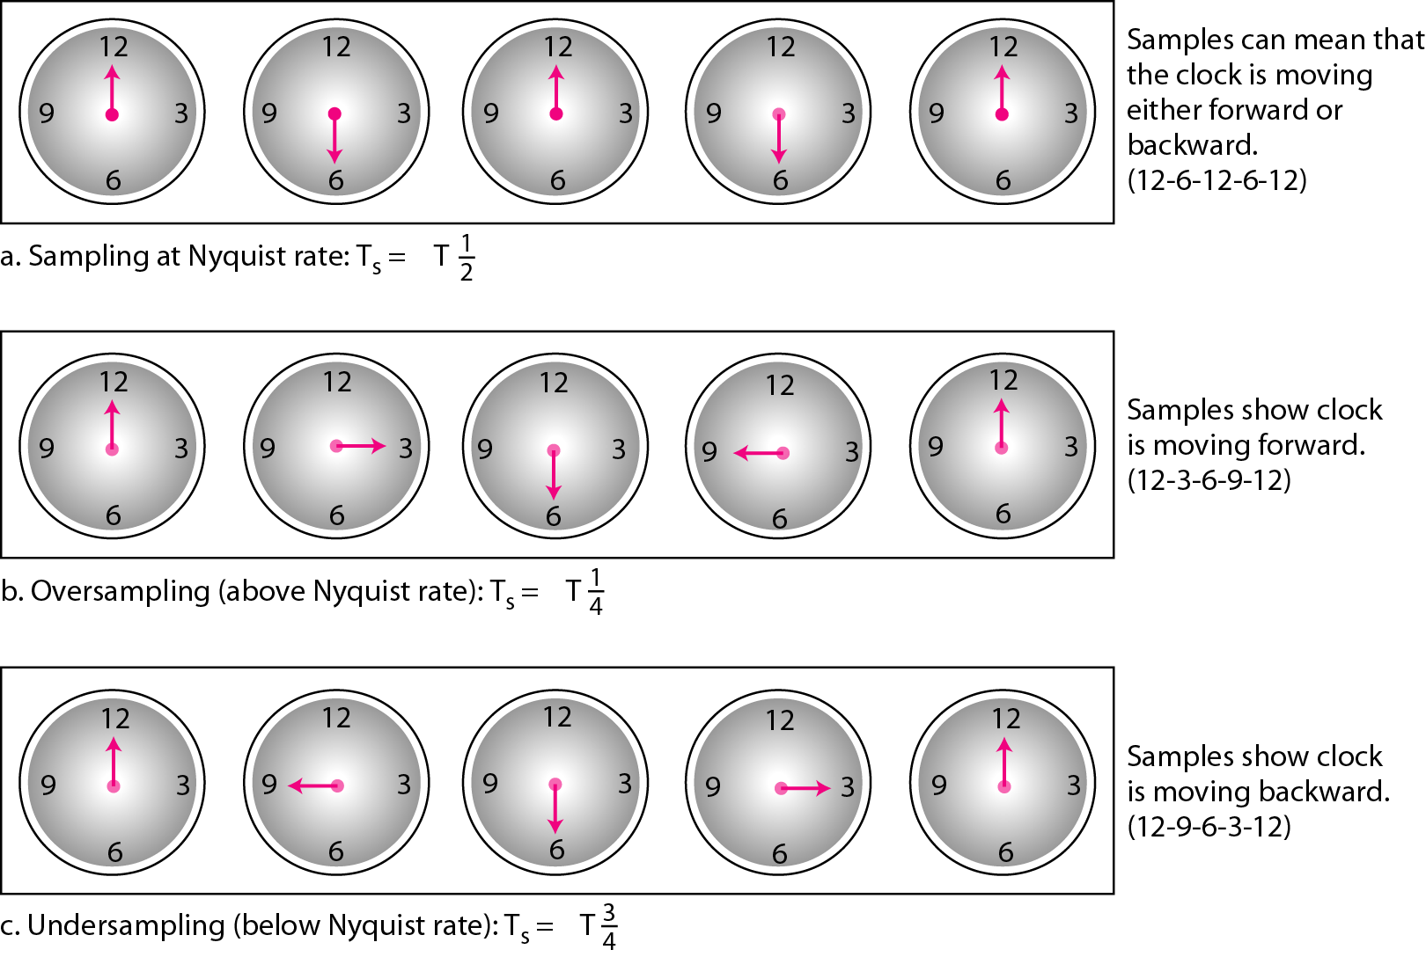
Figure Sampling of a clock with only one hand

Slide 59
Example
Telephone companies digitize voice by assuming a maximum frequency of 4000 Hz. The sampling rate therefore is 8000 samples per second.

Slide 60
Example
A complex low-pass signal has a bandwidth of 200 kHz. What is the minimum sampling rate for this signal?
Solution
The bandwidth of a low-pass signal is between 0 and f, where f is the maximum frequency in the signal. Therefore, we can sample this signal at 2 times the highest frequency (200 kHz). The sampling rate is therefore 400,000 samples per second.

Slide 61
Example
A complex bandpass signal has a bandwidth of 200 kHz. What is the minimum sampling rate for this signal?
Solution
We cannot find the minimum sampling rate in this case because we do not know where the bandwidth starts or ends. We do not know the maximum frequency in the signal.

Slide 62

2. Quantization
The result of sampling is a series of pulses with amplitude values between max and min amplitudes of the signal.
These values cannot be used in the encoding process
Following steps are perform in quantization:
We assume that the original analog signal has instantaneous amplitudes between Vmin and Vmax.
We divide the range into L Zones, each of height (delta).
We assign quantized values of 0 to L-1 to the midpoint of each zone.
We approximate the value of the sample amplitude to the quantized values.

Slide 63
2. Quantization
It is an approximation process. Value in the graph is an amplitude.
The first row shows normalized value amplitude/delta.
The quantization process selects the quantization value from the middle of each zone that is second row.
The difference is called the normalized error means third row.
The fourth row is the quantization code for each sample based on the quantization levels at the left of the graph.
Fifth row are the final products of the conversion.
Selection of Quantization Level based on amplitude values. In audio digitization L is normally chosen to be 256, In video it is normally thousands.
Choosing lower value of L increase quantization error.
If the input value is at the middle of the zone there is no quantization error.

Slide 64
Uniform versus Nonuniform quantization
It is used when amplitudes in the analog signal is not uniform.
In nonuniform quantization height of delta is not fixed. It is greater near the lower amplitudes and less near the higher amplitudes.
It is achieved using process of companding and expanding.
The signal is companded at the sender before conversion and expanded at the receiver after conversion.
Companding means reducing the instantaneous voltage amplitude for large values. Companding gives greater weight to strong signals and less weight to weak ones.
Expanding means the opposite process.

Slide 65
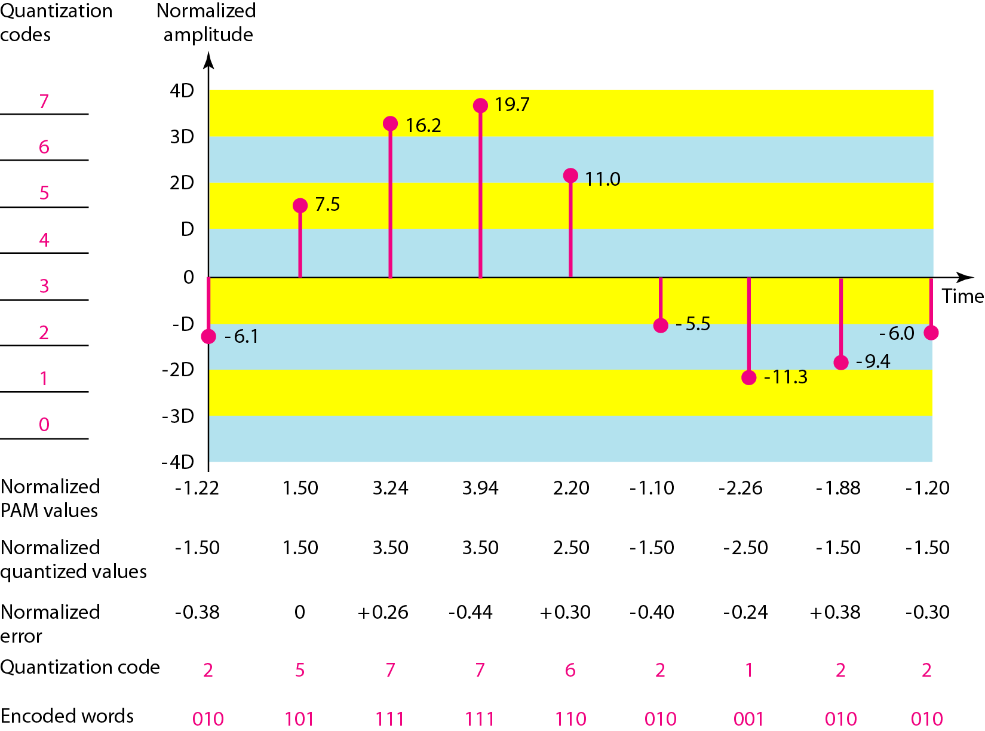
2. Quantization
Figure Quantization and encoding of a sampled signal

Slide 66
Encoding
After deciding number of bits per sample each sample can be changed to an n bit code word.
A Quantization code of 2 is encoded as 010, 5 is encoded as 101.
No of bits for each sample is determined from the number of quantization levels. N= log2L
Bit rate = sampling rate * number of bits per sample
At the receiver side decode convert bit to pulse that holds the amplitude until the next pulse.
After generating signal it is passed through a low-pass filter to smooth the staircase signal into an analog signal.
Filter has the same cutoff frequency as the original signal at the sender.
The maximum and minimum values of the original signal can be achieved by using amplification.

Slide 67
3. Encoding
Sampling rate = 2 * Highest Frequency
Bit rate = Sampling rate * no. of bits per sample
Example
We want to digitize the human voice. What is the bit rate, assuming 8 bits per sample?
Solution
The human voice normally contains frequencies from 0 to 4000 Hz. So the sampling rate and bit rate are calculated as follows:

Slide 68
Decoding
At the receiver side decode convert bit to pulse that holds the amplitude until the next pulse.
After generating signal it is passed through a low-pass filter to smooth the staircase signal into an analog signal.
Filter has the same cutoff frequency as the original signal at the sender.
The maximum and minimum values of the original signal can be achieved by using amplification.

Slide 69
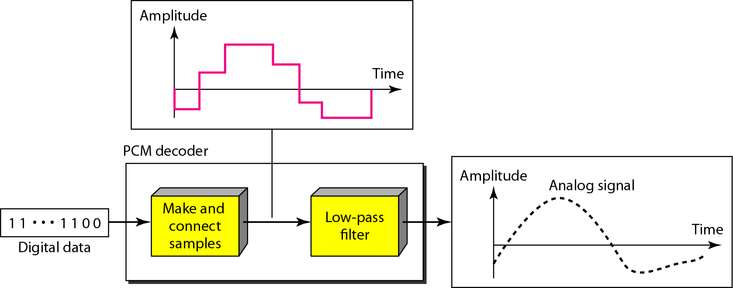
Original Signal Recovery
Figure Components of a PCM decoder

Slide 70
Example – PCM Bandwidth
We have a low-pass analog signal of 4 kHz. If we send the analog signal, we need a channel with a minimum bandwidth of 4 kHz. If we digitize the signal and send 8 bits per sample, we need a channel with a minimum bandwidth of 8 × 4 kHz = 32 kHz.

Slide 71
2. Delta Modulation
In PCM we finds the value of the signal amplitude for each sample while in DM finds the change from the previous sample.
There are no code words, bits are sent one after another.
Modulator:
It is used to create a stream of bits from an analog signal. The process records the small positive or negative changes called delta.
If the delta is positive the process records a 1 if it is negative the process records a 0.
The process needs a base against which the analog signal is compared.
The modulator builds a second signal that resembles a staircase, finding the change is then reduced to comparing the input signal with the gradually made staircase signal.
Modulator compares the value of analog signal with the last value of the staircase signal. If amplitude is larger next bit is 1 else 0.
It require delay unit to hold the staircase function for a comparison.

Slide 72
Demodulator
It takes the digital data and using the staircase maker and the delay unit creates the analog signal.
New signal passed through a low pass filter for smoothing.
The better performance can be achieved if the value of delta is not fixed. In adaptive delta modulation the value of delta changes according to the amplitude of the analog signal.
Quantization error is always introduced in the process. This error is less than error of PCM

Slide 73
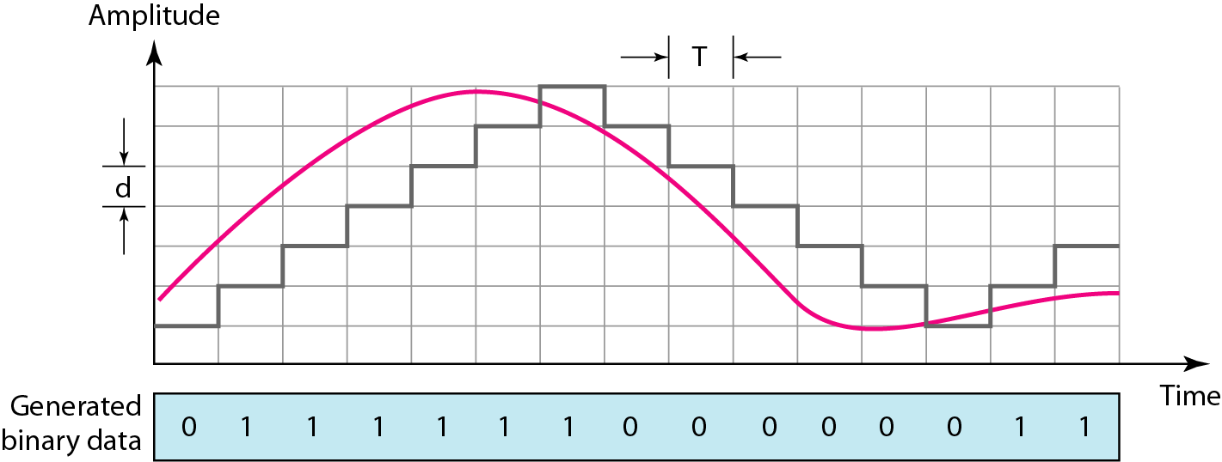
B. Delta Modulation (DM)
Figure The process of delta modulation

Slide 74
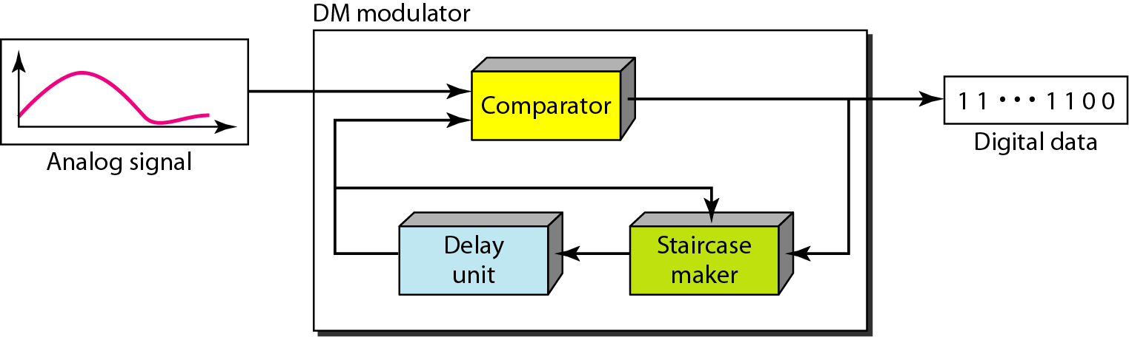
1. Modulator
Figure Delta modulation components

Slide 75
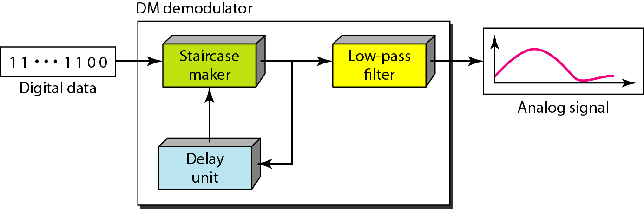
2. Demodulator
Figure Delta demodulation components

Slide 76
3. TRANSMISSION MODES
The transmission of binary data across a link can be accomplished in either parallel or serial mode.
In parallel mode, multiple bits are sent with each clock tick. there is only one way to send parallel data.
In serial mode, 1 bit is sent with each clock tick. there are three subclasses of serial transmission: asynchronous, synchronous, and isochronous.
There are two mode of transmission:
Parallel Transmission
Serial Transmission

Slide 77
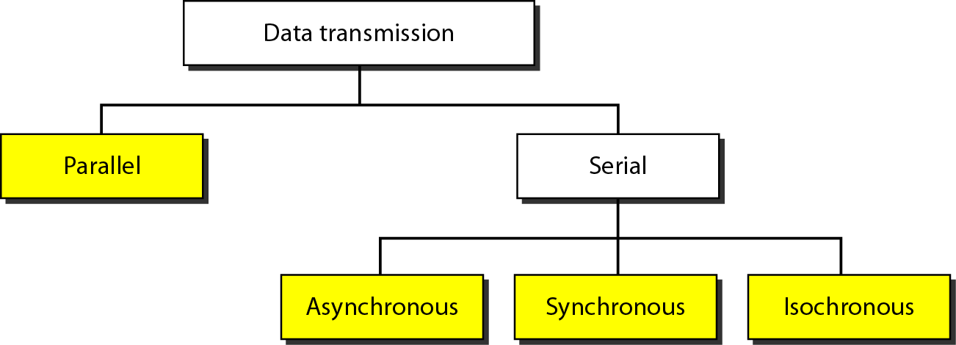
Figure Data transmission and modes

Slide 78
TRANSMISSION MODES
Parallel Transmission: I
n parallel transmission group of data send at a time.
Here n wires to send n bits at one time.
It provide speed of transmission that is advantage of parallel transmission.
But Increase overall cost of transmission is disadvantage.

Slide 79
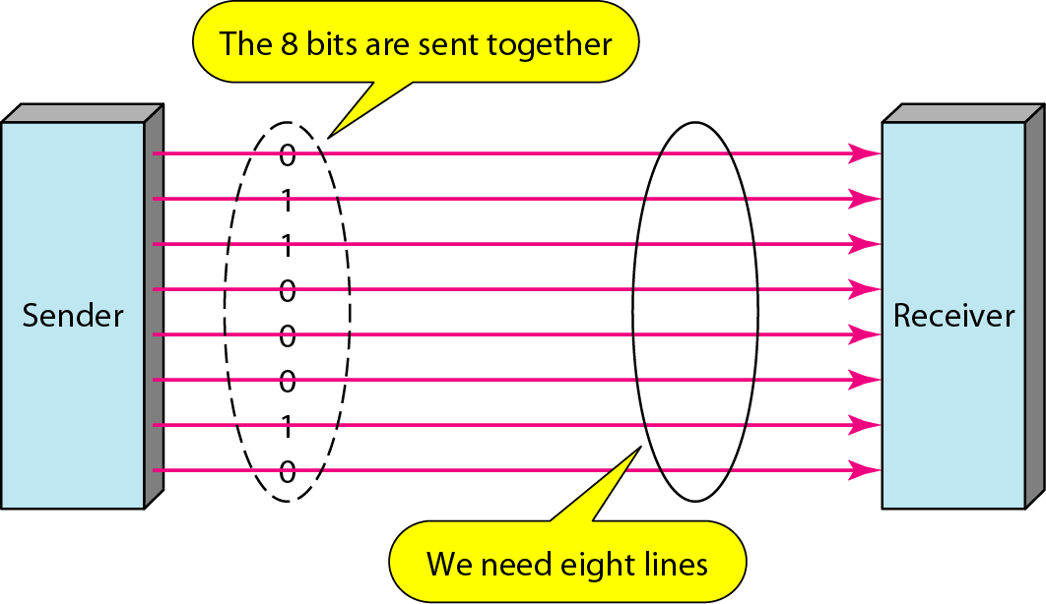
1. Parallel Transmission
Figure Parallel transmission

Slide 80
TRANSMISSION MODES
Serial Transmission:
In serial transmission only one channel is used to transmit n bit.
It reduced overall cost of transmission.
Here communication with devices is parallel so we required conversion devices for parallel to serial at sender side and serial to parallel at receiver side.
There are three way of doing serial transmission
Asynchronous
Synchronous
isochronous

Slide 81
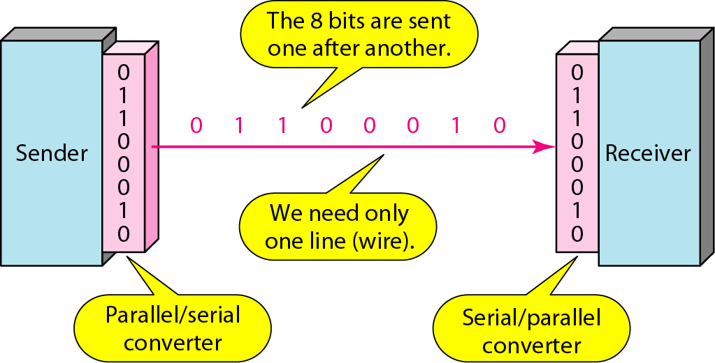
2. Serial Transmission
Figure Serial transmission

Slide 82
Asynchronous transmission:
It is asynchronous because timing is unimportant.
Here group of bits are gathered in the form of byte and send.
The sender handle each and every group independently.
To alert receiver extra bit is send with actual byte. 0 is send as a start bit and 1 as an stop bit.
Here size of message is increase due to extra 2 bit so total size is 10 bit.
There is gap provided between two different byte message to show idle channel.
Addition of start bit ,stop bit and gap makes transmission slower.
This scheme is cheap and effective for low speed communication.
Ex computer and keyboard communication.

Slide 83
In asynchronous transmission, we send 1 start bit (0) at the beginning and 1 or more stop bits (1s) at the end of each byte. There may be a gap between each byte.
Asynchronous here means “asynchronous at the byte level,” but the bits are still synchronized; their durations are the same.

Slide 84
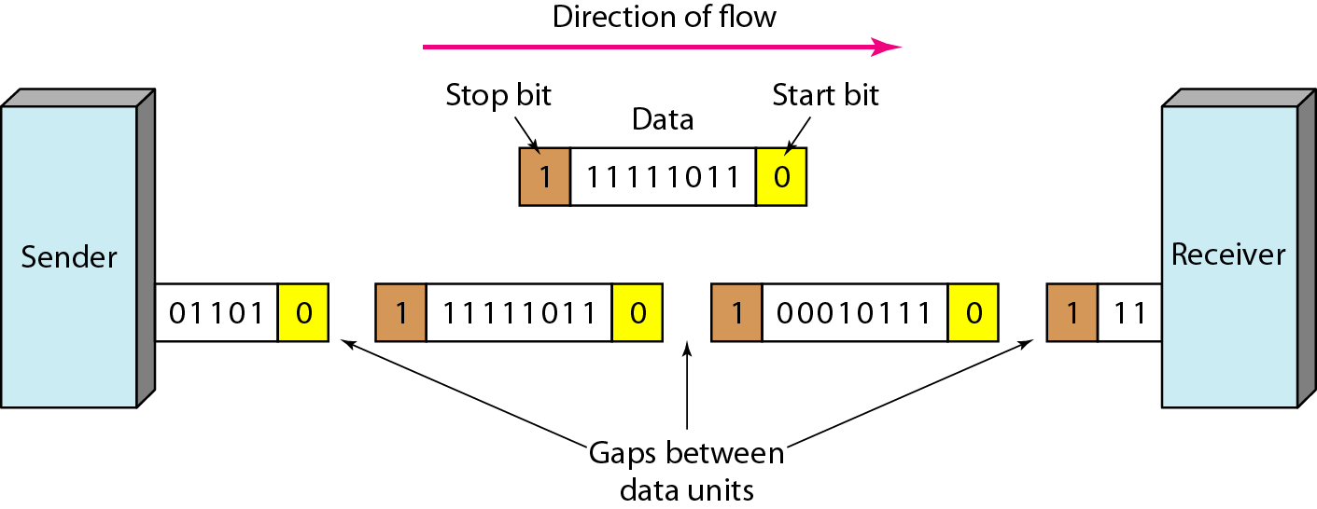
2.1 Asynchronous Transmission
Figure Asynchronous transmission

Slide 85
synchronous transmission:
In Synchronous transmission the bit stream is combined into larger “frames” which may contain multiple bytes.
There is no gap between two byte in frames.
It is the task of receiver to separate each byte.
Here sender must have to send information if no information available it fills gap using 0s and 1’s.
Here timing become very important because of no start bit, stop bit and gap available.
Advantage is speed because of no extra bits and gap.
It is used in high speed application for computer to computer transfer.
It happen at data link layer.

Slide 86
In synchronous transmission, we send bits one after another without start or stop bits or gaps. It is the responsibility of the receiver to group the bits.

Slide 87
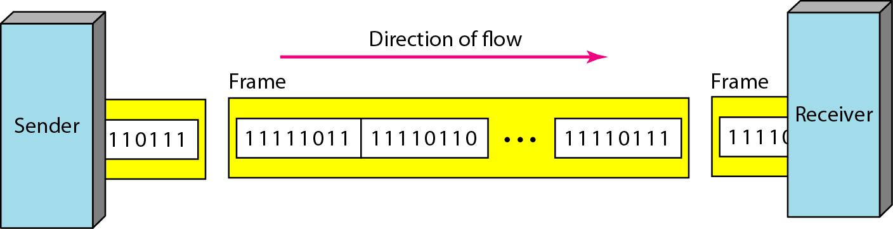
2.2 Synchronous Transmission
Figure Synchronous transmission

Slide 88
2.3 Isochronous Transmission
In real-time audio and video, in which uneven delays between frames are not acceptable, synchronous transmission fails.
For example, TV images are broadcast at the rate of 30 images per second; they must be viewed at the same rate.
If each image is sent by using one or more frames, there should be no delays between frames.
For this type of application, synchronization between characters is not enough; the entire stream of bits must be synchronized.
The isochronous transmission guarantees that the data arrive at a fixed rate.

Slide 89
Thank You

